Slide 1

Encapsulation
S1-2024-25, Object-Oriented Programming, Week 3

Slide 2
Objectives
Revise last week and lab.
Unpacking the benefits of encapsulation.
Public, private, and protected access modifiers.
Safeguarding data with encapsulation.

Slide 3
Revision

Slide 4

Lab Overview
90.65% class average

Slide 5
Lab Questions
What is the purpose of the update method in the provided code? To handle player input and interactions.
Which menu option should players select to continue the game once it has started? ‘c’
What Python construct is used to execute different code blocks based on a specified condition? if-else statement
What is the significance of the self.running attribute in the Game class? It indicates whether the game is running or not.
Notes:
And 4. check if you have understood the code base that you were given
2 checks if you have read the instructions to the lab.
3 checks your general knowledge of programming. This is not specific to Python.

Slide 6
Lab Code Discussion
Overall very good:
Good naming of variables and methods,
Good if-else statements,
Good commenting in most cases,
Creative options!
Biggest issue: Ability to follow instructions – or lack thereof.
Naming of the submission file.
Methods to edit.
Discussion on lab code rubrics (published on brightspace).

Slide 7

Debugging Code
Understanding Code: Debugging is a great way to explore how someone else's code works or to learn from your own previous work. It can help you understand complex systems better.
Identifying Issues: Debugging is like finding and fixing mistakes in your computer programs.
Finding Errors: It helps you locate things that don't work the way you intended them to.
Making Code Better: By debugging, you improve your code to run smoothly and do what it's supposed to.
Step-by-Step: Debugging often involves going through your code step by step to catch errors.

Slide 8
Breakpoints
A breakpoint is a point in your code where you want the debugger to pause execution so you can inspect the program's state.
Breakpoints are essential for controlling the flow of your code during debugging.
Types of Breakpoints:
Line Breakpoints: Pauses execution at a specific line of code.
Conditional Breakpoints: Pause only when a specific condition is met.
Exception Breakpoints: Pause when a particular exception is raised.
Setting Breakpoints in PyCharm:
In PyCharm, you can set breakpoints by clicking in the left margin next to the line numbers in the code editor.
Or you can use the keyboard shortcut (F8).

Slide 9
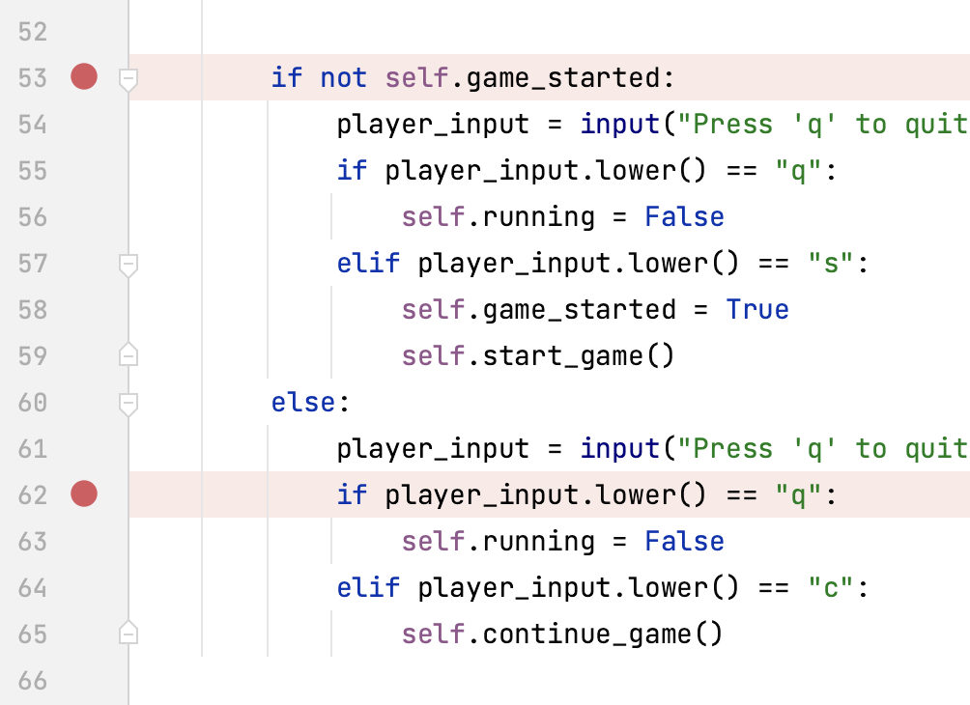
Breakpoints in Pycharm
Click into the left gutter to create a breakpoint.
Breakpoints do not suspend execution during the normal code running mode.
Breakpoints can be set interactively while you are running the debugger.

Slide 10
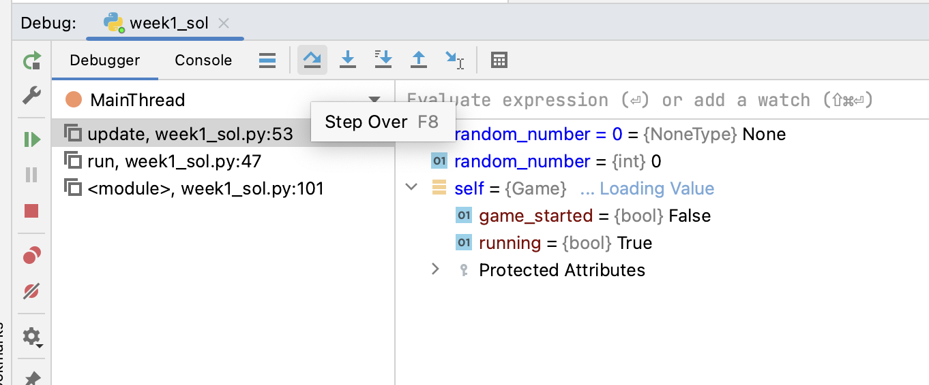
Step Through your Code
Step over: Steps over the current line of code and takes you to the next line even if the highlighted line has method calls in it. Probably most common choice.
Step into my code: 2nd most common choice.
Many others. Start with 1-2 and get to know them well before moving on.
[1]

Slide 11
Common Debugging Scenarios
Debugging Logic Errors:
Identifying and correcting logical errors in the code.
Understanding when the program doesn't produce the expected results.
Inspecting Variables:
Examining the values of variables at specific points in the program.
Understanding how data changes during execution.
Handling Exceptions:
Identifying exceptions and their causes.
Troubleshooting exceptions to improve code stability.
Investigating Performance Issues:
Profiling and analysing code for performance bottlenecks.
Finding and optimizing resource-intensive sections of the code.

Slide 12
Demo of Debugging

Slide 13
True or False?
Debugging is a process that helps identify and fix errors or issues in code, making it easier to understand existing code.

Slide 14
Main Points from Last Week
Lots of OOP terminology.
Classes, attributes, methods and objects.

Slide 15
Encapsulation

Slide 16
Definition of Encapsulation
Encapsulation is the practice of bundling the data (attributes) and methods (functions) that operate on the data into a single unit known as a class.
It allows the internal state of an object to be protected from unintended interference and modification.
Data Hiding: Encapsulation promotes data hiding, making the internal data of an object private, accessible only through well-defined methods. This prevents unauthorized access and manipulation of data.
Maintainability: Encapsulation ensures that changes to the internal structure of a class do not affect the code that uses the class. This simplifies maintenance and reduces the risk of introducing errors.
Flexibility and Control: By providing well-defined methods for accessing and modifying data, encapsulation offers greater control over data behaviour. It allows you to enforce constraints and ensure data integrity.

Slide 17
Access Modifiers in Python
Access modifiers are keywords used in object-oriented programming to control the visibility and accessibility of class members (attributes and methods). These modifiers determine who can access or modify class members and provide essential security and encapsulation features. In Python, there are three primary access modifiers: public, private, and protected. Python is not strict about this.
Public (Default): Members declared without any access modifier are considered public. They can be accessed from outside the class.
Protected (_): Members prefixed with single underscores (e.g., _variable) are considered protected. While they can be accessed outside the class, it is a convention not to do so directly.
Private (__): Members prefixed with a double underscore (e.g., __variable) are considered private. They should not be accessed or modified directly from outside the class, although Python doesn't enforce this rule. Python uses “name mangling” to achieve the effect.

Slide 18
Public Access Modifier
In Python, the public access modifier is the default access level for class members, meaning that they can be accessed and modified from anywhere in the code. However, it's essential to understand the various aspects and advanced use cases of the public access modifier to maximize its potential.
Public members have no access restrictions, meaning they can be accessed and modified from any part of the code.
They are widely used to represent the interface of a class, as they define how objects of the class interact with the external world.

Slide 19
Public Access Modifier: Attribute
class Book: def __init__(self, title, author): self.title = title self.author = author book = Book("Python 101", "John Doe") print(book.title) # Accessing a public attribute

Slide 20
Public Access Modifier: Method
class Calculator: def add(self, x, y): return x + y calc = Calculator() result = calc.add(5, 7) # Accessing a public method print(result)
Public methods define how objects interact with the class and other classes.
They are accessible from outside the class and can be used to perform various operations.

Slide 21
Private Access Modifier
The private access modifier in Python is crucial for maintaining data integrity and protecting sensitive information within a class. In this section, we'll delve deeper into the private access modifier and its significance. An "afterthought" in Python.
Members designated as private are prefixed by a double underscore (__). Achieved through name mangling.
Private members are not accessible outside the class in which they are defined.

Slide 22
Private Access Modifier: Attribute
class SecretAgent: def __init__(self, name, code): self.__name = name # Private attribute self.__code = code # Private attribute def introduce(self): return f"My name is {self.__name}." agent = SecretAgent("James Bond", "007") print(agent.introduce()) print(agent.__name) # This will raise an AttributeError

Slide 23
Private Access Modifier: Method
class Student: def __init__(self, name, age): self.__name = name self.__age = age def __validate_age(self, age): if age < 16: return 16 # Ensure the minimum age is 16 return age def update_age(self, new_age): self.__age = self.__validate_age(new_age) student = Student("Alice", 15) student.update_age(14) # The private method ensures the age is set to 16 student.__validate_age(20) # This will raise an AttributeError

Slide 24
Protected Access Modifier
Members designated as protected are prefixed by a single underscore (_).
Protected members are accessible within their class and derived classes. We discuss inheritance next week. It is supposed to be used like the private access modifier, but for related classes.
This access modifier aims to balance data hiding and providing limited access when needed.

Slide 25
When is the Protected Access Modifier Useful?
Inheritance and Code Reusability
Protected members allow derived classes to access and modify data from their base class.
Inherited attributes and methods can be reused and adapted in derived classes, reducing code duplication.
We cover inheritance next week!
Extension and Specialization
Derived classes can further extend and specialize the behaviour of base classes by accessing and overriding protected members.
This is valuable in cases where a base class provides common functionalities that derived classes customize.
Controlled Access
The protected access modifier offers a level of controlled access to class members. This ensures data integrity while allowing for inheritance-based customization.

Slide 26
True or False?
Through encapsulation, all class attributes and methods are accessible from outside the class.

Slide 27
Why Data Hiding is Essential
Data Security
Private members protect sensitive data from being accidentally or intentionally modified from outside the class.
Prevents unauthorized access and manipulation of critical attributes.
Code Maintenance
Data hiding simplifies the debugging process by localizing potential issues to the class's methods.
Modifications to the internal data structure of the class do not affect external code.
Enhanced Encapsulation
Encapsulation is strengthened as private members define a clear boundary between a class's interface and its internal implementation.
External code interacts with the class through public methods, ensuring a clean and predictable interface.

Slide 28
Traditional Getter and Setter Methods
Getter and setter methods are used to access and modify the attributes of a class.
Getter Methods:
A getter method allows you to retrieve the value of an attribute.
Typically, a getter method has the same name as the attribute it retrieves.
It uses the return statement to provide the value.

Slide 29
Traditional Getter and Setter Methods Cont’d
Setter Methods:
A setter method allows you to modify the value of an attribute.
Typically, a setter method has the same name as the attribute it sets.
It uses parameters to accept the new value and assigns it to the attribute.

Slide 30
Usage
In Python, you can use these methods to control access to class attributes and perform additional operations when getting or setting values.
Traditional getter and setter methods offer a basic level of data protection and encapsulation.
def get_attribute(self): return self.attribute
def set_attribute(self, new_value): self.attribute = new_value
obj = MyClass() obj.set_attribute(42) # Setter method value = obj.get_attribute() # Getter method

Slide 31
Drawbacks of Traditional Getter and Setter Methods
Limited Control:
Traditional methods offer limited control over attribute access.
You can't easily add validation or additional behaviour when getting or setting attributes.
Complexity:
In classes with many attributes, you end up with a large number of methods, making the code complex and harder to maintain.
Boilerplate Code:
Writing getter and setter methods for every attribute results in boilerplate code that can be tedious to write and maintain.
Verbosity:
Having to create separate methods for getting and setting attributes can lead to verbose code, especially when dealing with classes that have many attributes.
It can make the class definition longer and less readable.
Less Pythonic:
Python encourages concise and readable code.
The traditional approach is not considered very Pythonic.
Notes:
In programming, a "boilerplate method" typically refers to a standard or generic piece of code that is used in many places with little or no alteration. These methods often serve as templates or scaffolding for various tasks and are reused to ensure consistency and to save time when writing code.
The term "boilerplate" essentially means that the code is generic, repetitive, and often similar across different parts of a program. It's used to save time and maintain consistency. However, excessive boilerplate code can also make the codebase harder to maintain, so it's important to strike a balance between reusing boilerplate code and keeping the codebase clean.
In OOP, boilerplate methods can include constructors, getters and setters, and other standard methods that are common to many classes.

Slide 32
Introduction to Decorators
Decorators are a powerful and flexible feature in Python.
They allow you to modify or enhance functions or methods.
Decorators are applied using the "@" symbol followed by the decorator name.
They provide a way to extend or modify the behaviour of functions or methods without changing their code.
A decorator is a function that takes another function or method as its argument.
It can add new functionality, modify the existing functionality, or even prevent the original function from being called.
Decorators are widely used in Python for various purposes, including logging, authorization, validation, and more.
Decorators can be used to create getter and setter methods for attributes in a more Pythonic way, which will be discussed in the following slides.

Slide 33
Python Property Decorator
In Python, the @property decorator is used to define a method as a "getter" for an attribute.
It allows you to access an attribute like a method but without using parentheses.
The @property decorator is placed above a method that is used to retrieve the value of an attribute.
Property decorators provide a more elegant and Pythonic way to access attributes.
They eliminate the need for explicit getter methods and make your code cleaner and more readable.

Slide 34
Python Setter Decorator
In Python, the @<attribute>.setter decorator is used to define a method as a "setter" for an attribute.
It allows you to set the value of an attribute as if you were assigning it directly.
Creating Setter Methods:
By using the @<attribute>.setter decorator, you can make a method act as a setter method.
The setter method is used to assign a new value to an attribute as if it were a direct assignment.

Slide 35
Example
# Creating a Student object student = Student("Alice") # Accessing and modifying attributes using properties print(f"Original Name: {student.name}") student.name = "Bob" print(f"Modified Name: {student.name}") # Attempting to set invalid values student.name = "A" # Won't change the name due to length check
class Student: def __init__(self, name): self.__name = name @property def name(self): return self.__name @name.setter def name(self, new_name): if len(new_name) >= 3: self.__name = new_name else: print("Name should be at least 3 characters long.")

Slide 36
True or False?
Python decorators are used to modify or enhance functions or methods.

Slide 37
Real World Analogies to Encapsulation
Luggage and Suitcase Analogy
Imagine a suitcase as a class and your clothes and personal items as data (attributes).
Encapsulation is like zipping up your suitcase; it conceals your belongings and provides protection.
You interact with your suitcase through a limited set of actions (methods) such as opening, closing, and locking it.
Medicine Pill Bottle Analogy
In this analogy, think of a medicine pill bottle as a class, the pills as data, and the childproof cap as a method.
Encapsulation is akin to securing the pills within the bottle, ensuring they remain uncontaminated and safe.
To access the pills (data), you need to follow a specific method (childproof cap) to open the bottle.
Smartphone Case Analogy
Consider a smartphone case as a class, your phone as data, and the case's protective features (like a screen protector) as methods.
Encapsulation safeguards your phone from potential damage and unauthorized access.
You interact with your phone through the case's protective features (methods), ensuring its security and functionality.

Slide 38
Advantages of Encapsulation
Data Protection: Encapsulation prevents unauthorized access and modification of data, reducing the risk of data corruption.
Enhanced Security: By controlling data access, encapsulation enhances the security and integrity of your program.
Modularity: Encapsulation enables modular development, as you can change the internal implementation of a class without affecting its external usage.
Code Maintenance: It simplifies code maintenance and debugging by encapsulating data and behaviour within the same unit.
Real-World Analogy: The real-world analogies help convey the importance of encapsulation to non-programmers.

Slide 39
Best Practices
Consistent Naming Conventions
Use clear and consistent naming conventions for your classes, methods, and attributes.
Prefix private attributes with an underscore (_) to indicate their intended limited access.
Keep Data Hidden
Limit direct access to class attributes by making them private.
Provide getter and setter methods to access and modify the data, respectively.
This enhances data security and ensures that changes adhere to predefined rules.
Documentation
Include descriptive comments and docstrings to explain the purpose of classes, methods, and attributes.
Proper documentation helps other developers understand your code and accelerates debugging.

Slide 40
Best Practices cont’d
Single Responsibility Principle
Follow the Single Responsibility Principle (SRP) by ensuring that each class has a single, well-defined responsibility.
A class should encapsulate one piece of functionality.
Access Modifiers
Use access modifiers wisely:
Public: Only when an attribute or method needs to be accessible from outside the class.
Protected: In cases where limited accessibility within subclasses is required.
Private: For attributes or methods that should not be accessed externally.
Code Testing
Regularly test your code to ensure that encapsulation and data handling work as expected.
Use unit tests to validate the behaviour of individual classes and methods.

Slide 41
Best Practices cont’d
Modularity and Reusability
Emphasize modularity by creating classes that can be reused in various parts of your code.
Encapsulation fosters modularity and allows you to modify internal implementations without affecting external usage.
Error Handling
Implement appropriate error handling and validation mechanisms in your setter methods to prevent invalid data assignments.
Code Reviews
Consider peer code reviews as a valuable practice.

Slide 42
References
Pycharm: Debug, step through your program, https://www.jetbrains.com/help/pycharm/stepping-through-the-program.html#step-over, accessed Sep 2023.
Unicode based Emojis,
https://unicode.org/emoji/charts/emoji-list.html

Slide 43
Contact Me
Via E-Mail
SunderAli.Khowaja@tudublin.ie
Or contact the School Office:
school.cs@tudublin.ie

